Slide 1
How http works…?

Slide 2
HTTP Request / Response
A client (a browser) sends an HTTP request to the web
A web server receives the request
The server runs an application to process the request
The server returns an HTTP response (output) to the browser
The client (the browser) receives the response

Slide 3
The HTTP Request Circle
The browser requests an HTML page. The server returns an HTML file.
The browser requests a style sheet. The server returns a CSS file.
The browser requests an JPG image. The server returns a JPG file.
The browser requests JavaScript code. The server returns a JS file
The browser requests data. The server returns data (in XML or JSON).

Slide 4
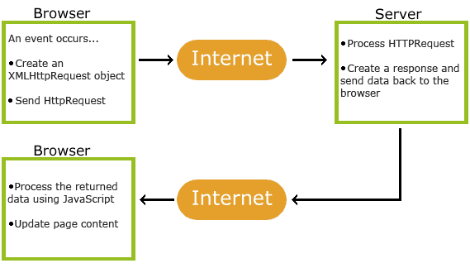
XHR - XML Http Request

